Slide 1
EmergencyAlerter
Arlinda Butja
Florian Mayerhofer
Michael Stifter
IMS16

Slide 2

Idea
Emergency Alerter
Oh no, not again!

Slide 3
Features
Large, easy to use emergency buttons
Simple settings menu
Map with your location and the police stations around you
Notifications reminding you to check your settings
Call-On-Shake
Fancy animations
Vibration
…

Slide 4
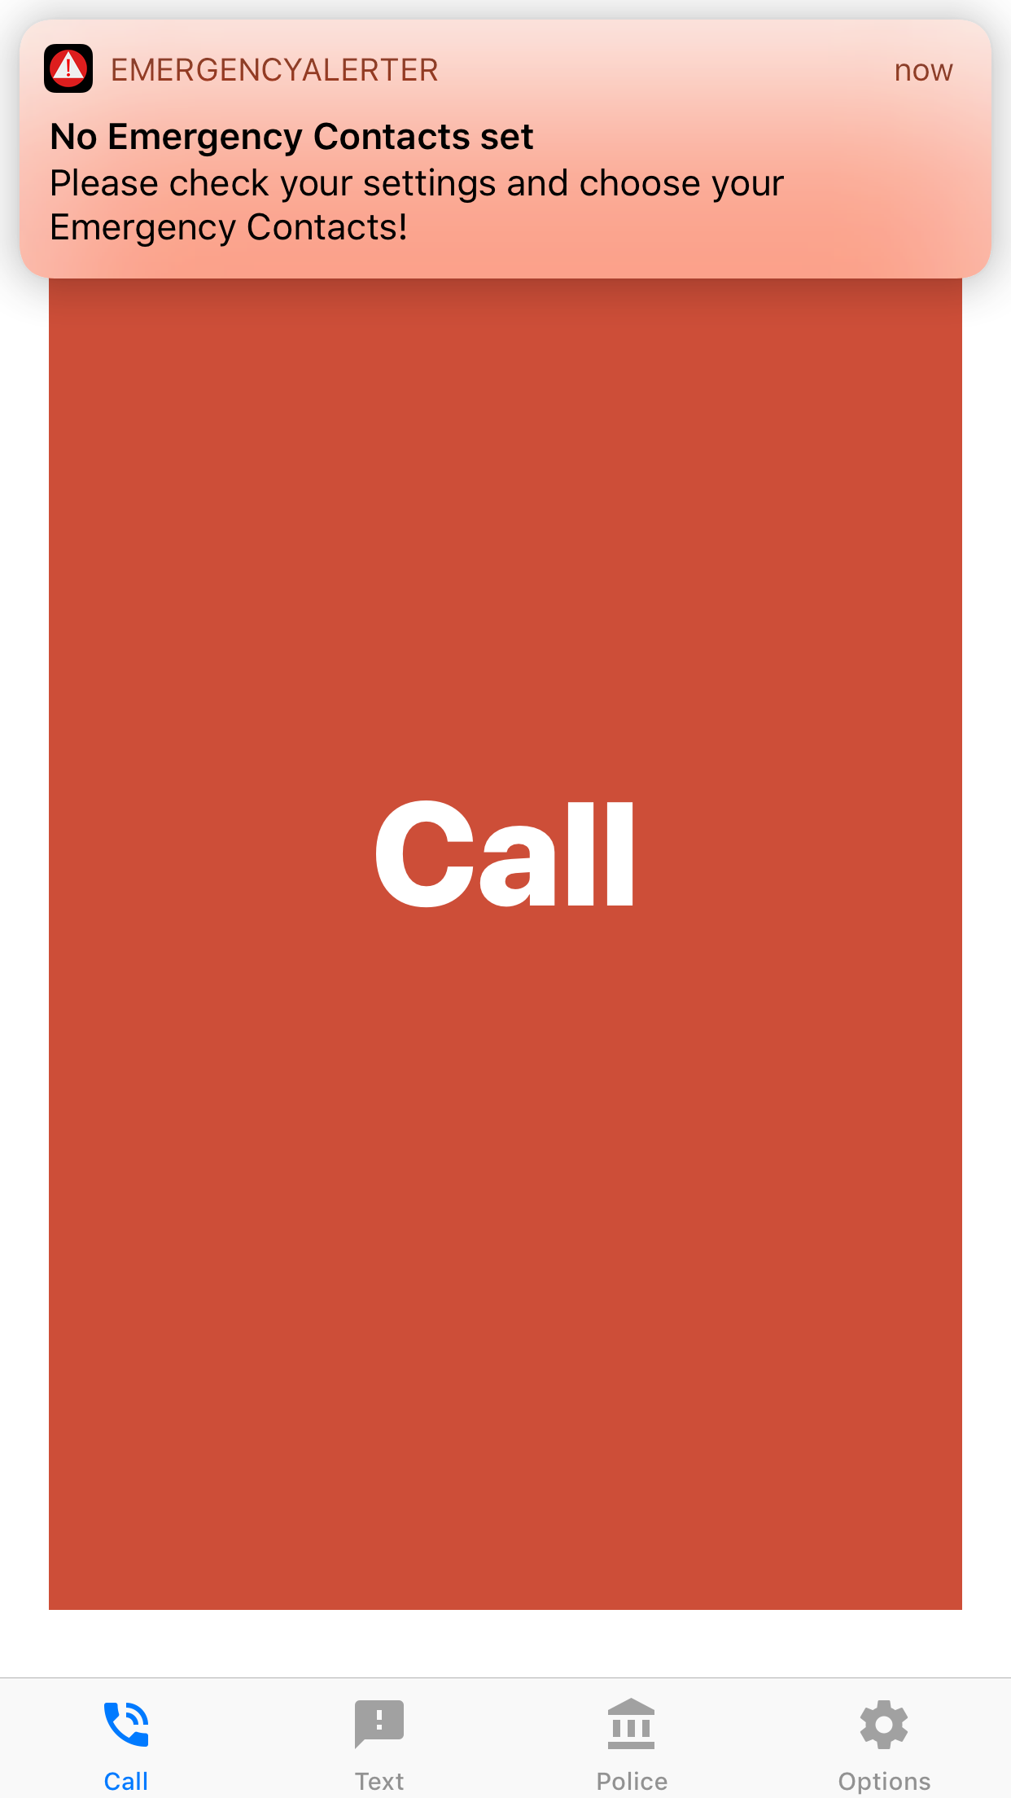
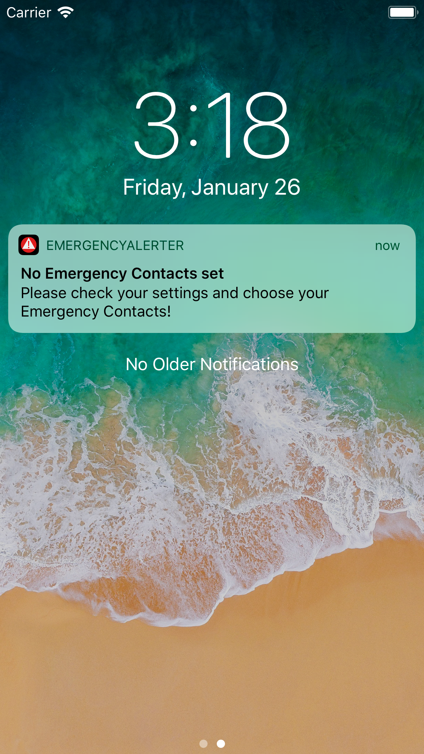


Slide 5
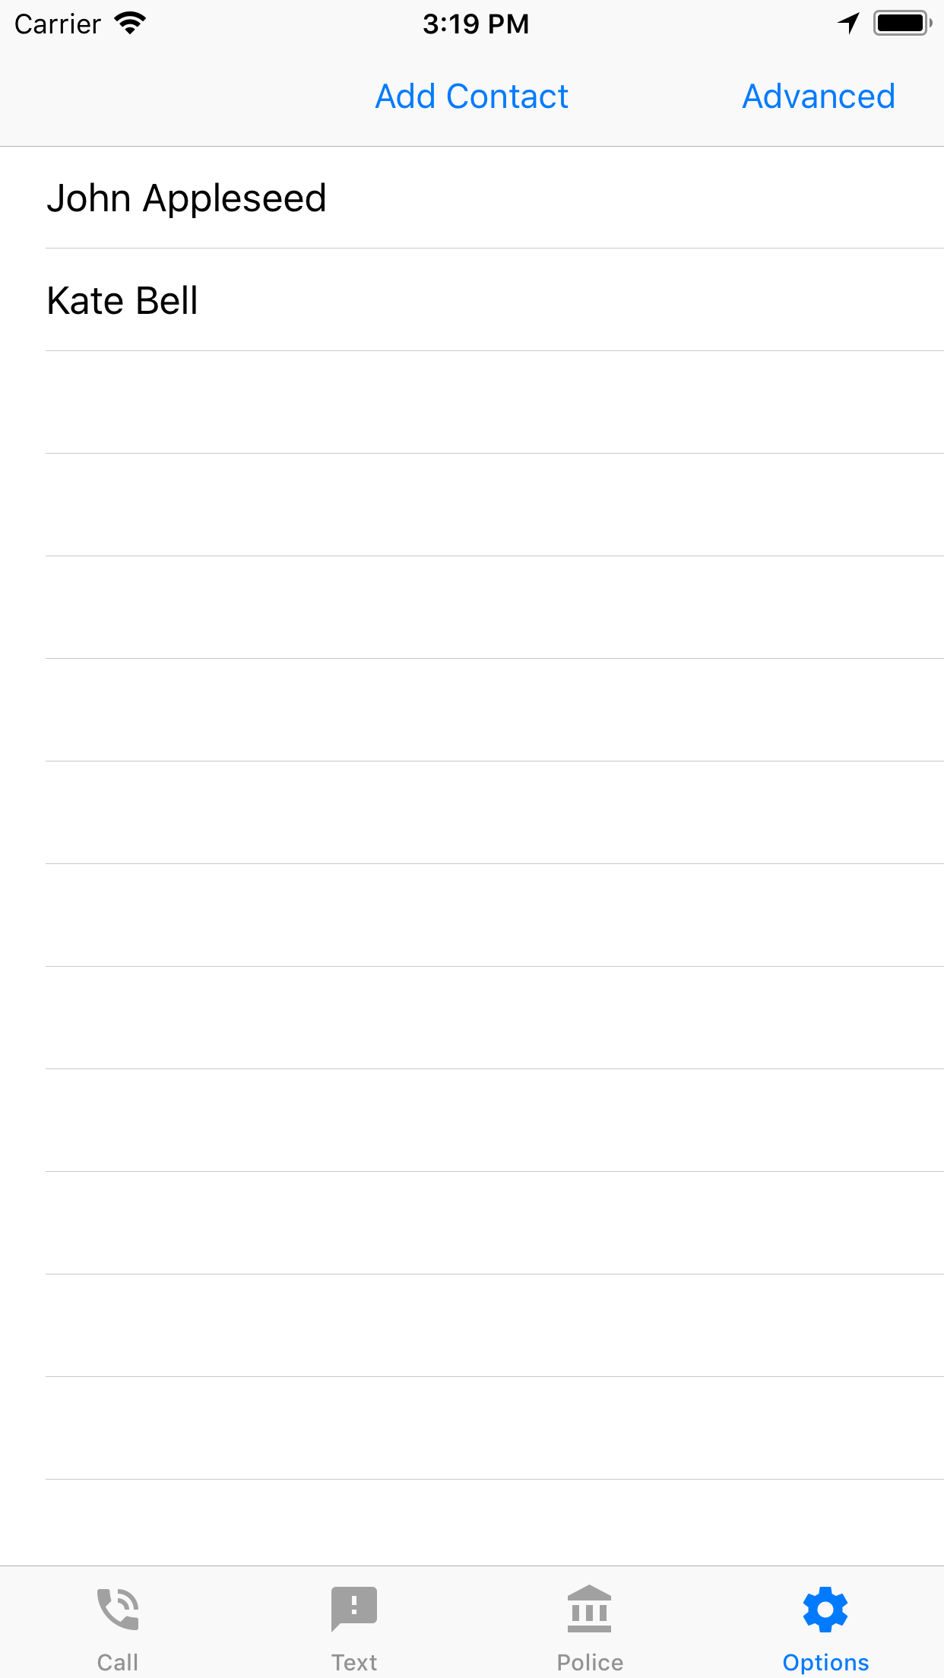
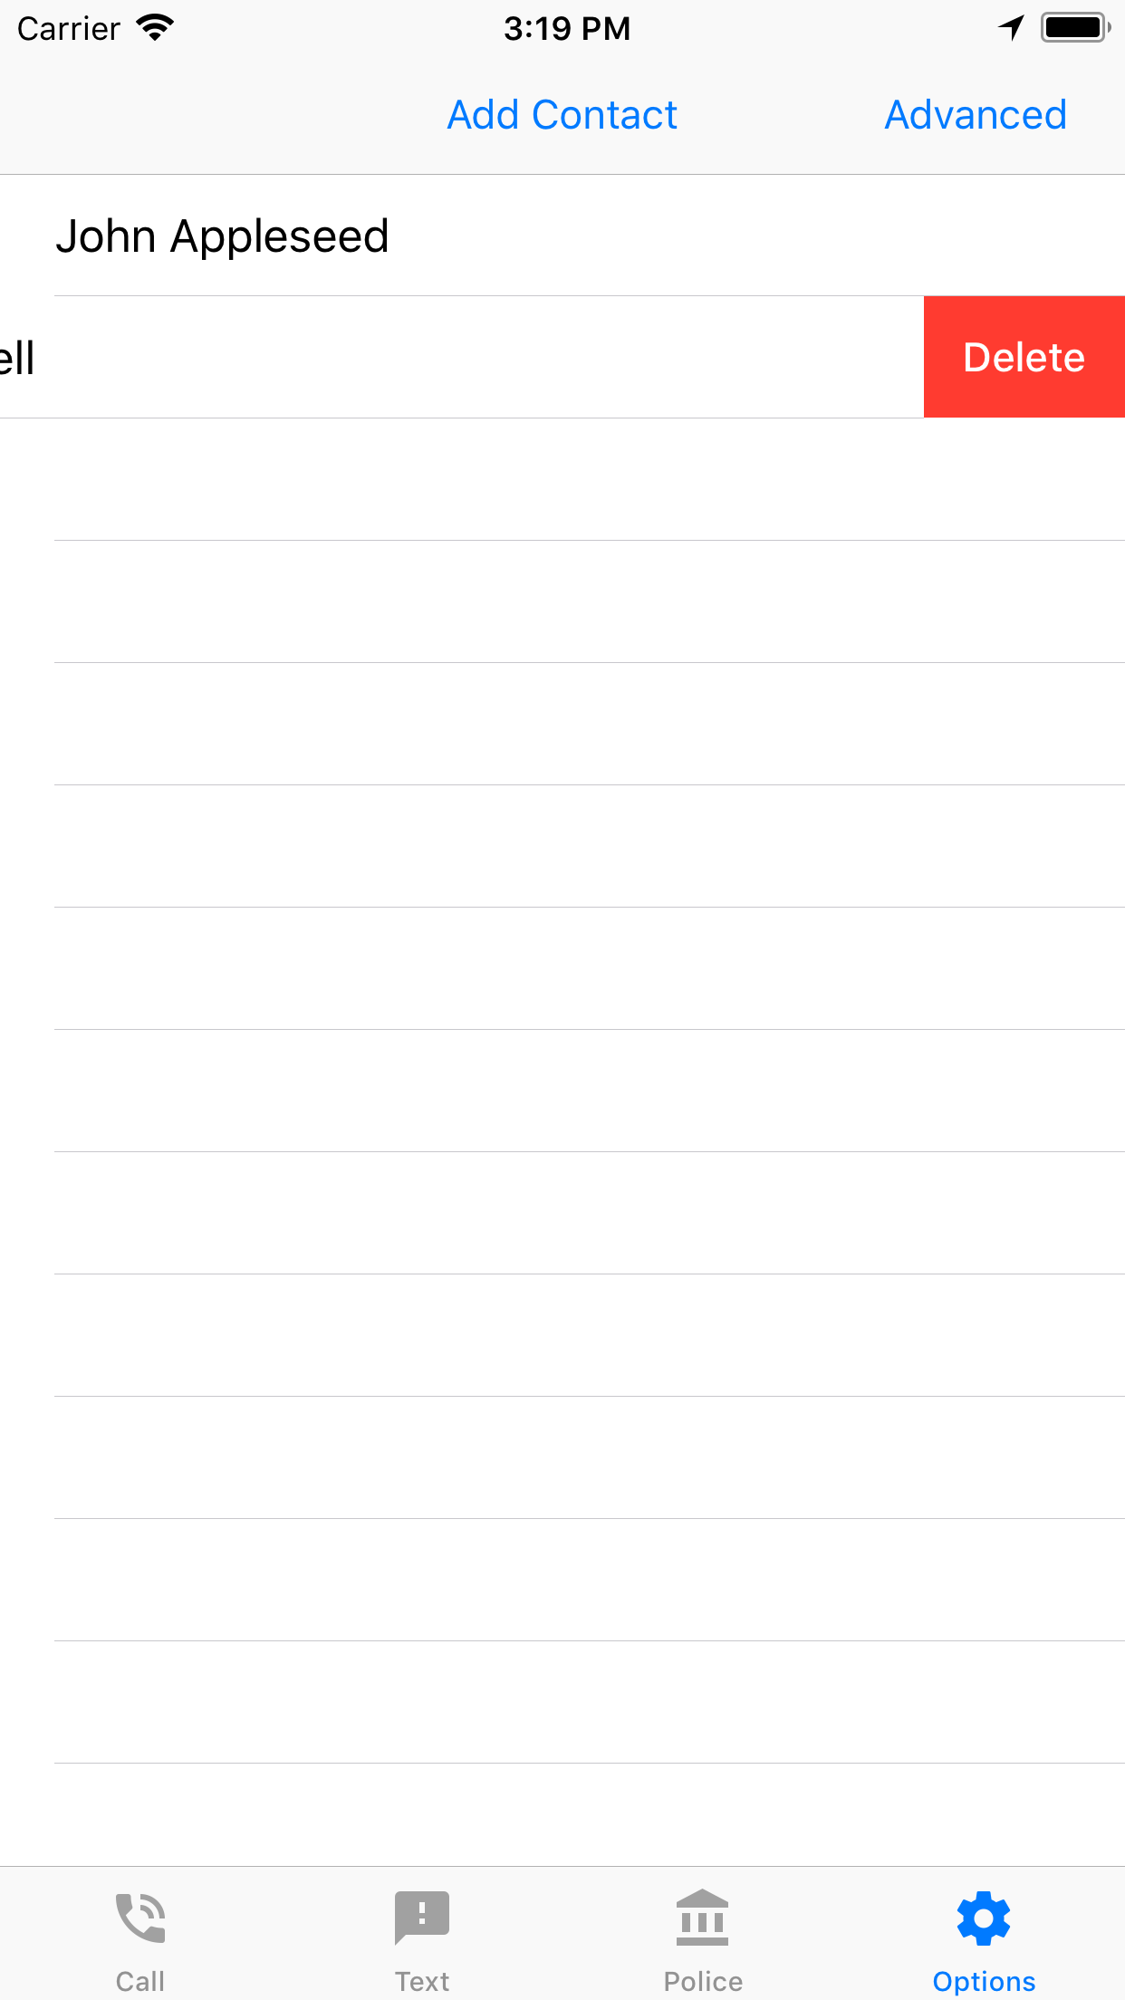

Slide 6
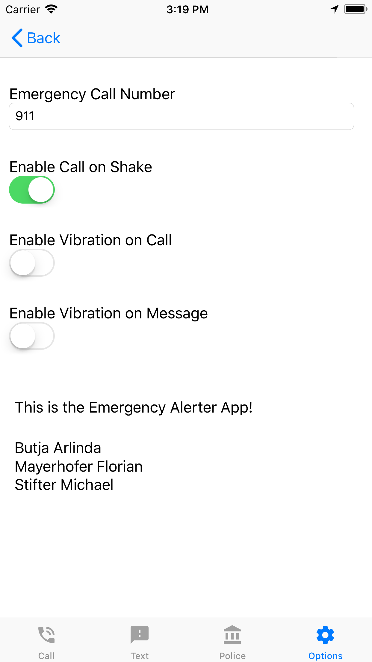
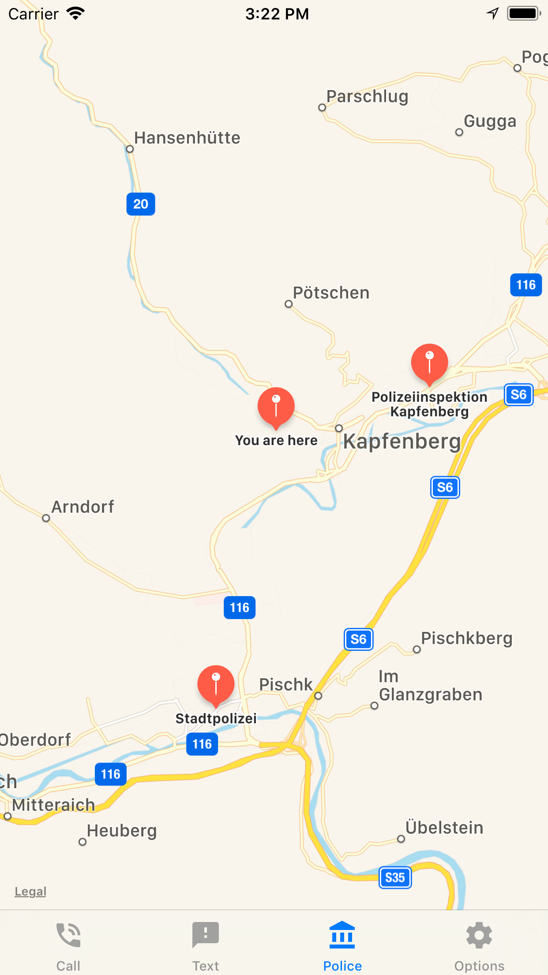

Slide 7
As for the code
ContactsPickerDelegate
NotificationDelegate
CoreData & UserDefaults
GeoLocation
UrlSchemes
Grand Central Dispatch
CocoaPods - AlamoFire

Slide 8
Live Demo

Slide 9
What we have learned
Swift is an interesting language offering many features
Xcode is not our favourite IDE
The Apple Ecosystem has a high entry barrier
As mentioned, refactoring is quite hard

Slide 10
